Slide 1

A Brief Review of 2025

Slide 2
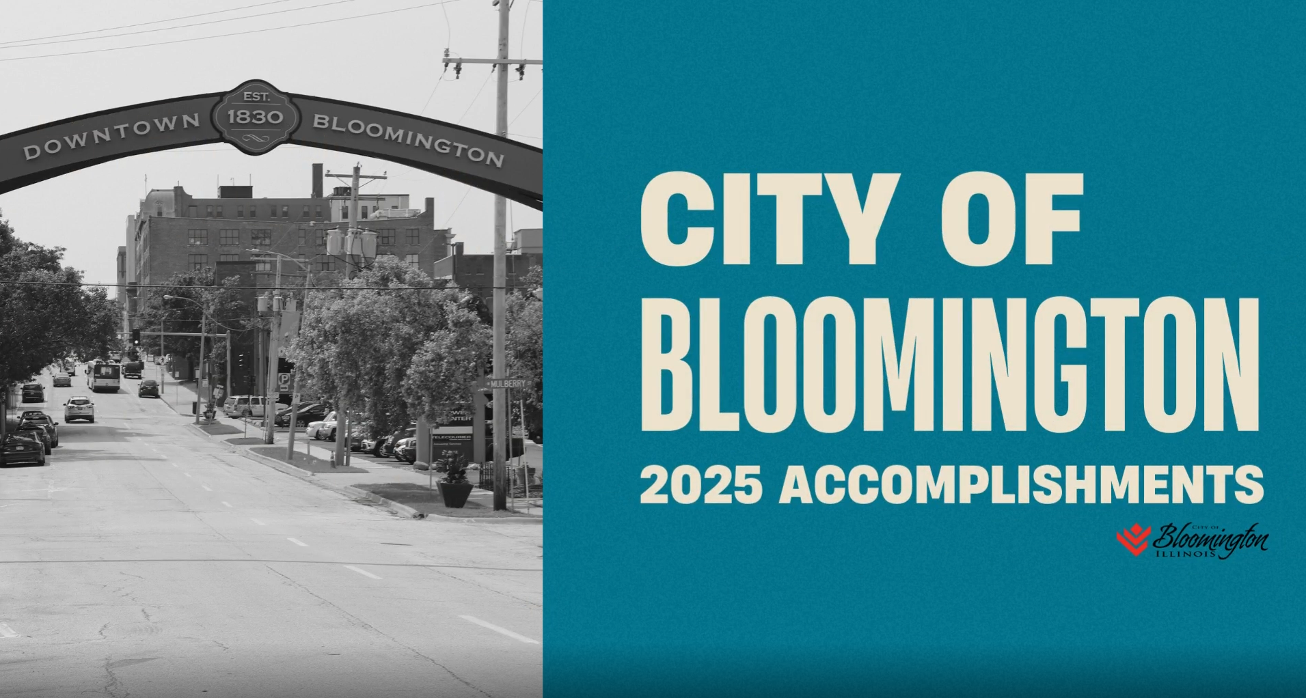
Video Presentation

Slide 3

2025 Achievements: Supporting Departments
City Clerk
  Nearly 4,000 FOIA Requests
    48% increase from previous 2024
    On average
      4-day response time for regular requests
      14-day response time for commercial requests
  600+ business and liquor licenses
    $11.5M in licensing revenue
  15+ Boards & Commissions
  1,000+ Legislative Records
  Does all this and more with only 4 people!

Slide 4

2025 Achievements: Supporting Departments
Finance Department
  36 bank account & credit card reconciliations completed every month
  2,000+ vendor payments processed every month
  30,000 utility bills and payments processed every month.
  $65M+ in annual revenues processed.
  Customer Service Contacts at the HUB each month
    900+ in-person visits
    2,500+ resident and customer calls
  Annual Comprehensive Financial Report – GFOA Certificate of Achievement
  Annual Budget

Slide 5

2025 Achievements: Supporting Departments
Human Resources
  11 bargaining units
    7 negotiated in 2025!
      Implementation of new Fire schedule
  Supports more than 1,800 employees (full time and seasonal) in any given year
  Oversees benefits, compensation, recruitment, workforce development, health programs, safety and risk management, worker’s compensation, time and attendance.
    Maintains a ratio of .84 per 100 employees
  Implementation of NEOGOV in 2025

Slide 6

2025 Achievements: Supporting Departments
Information Technology
  Processed over 7,000 service requests for hardware, software, network, and security support across all departments.
    Achieved 90% SLA compliance on resolution times while handling increased ticket volume.
  Responsible for 1,400+ City technology users across 14 departments.
  Manages 5,000 devices including computers, mobile devices, and servers that support citywide operations.
  Supports public safety’s 24/7 operations.

Slide 7

2025 Achievements: Supporting Departments
Legal Department
  Filed nearly 200 property maintenance and over 375 behavioral ordinance cases.
  40 solicitations totaling over $86M in contracts.
  Reviewed and approved over 2,400 invoices totaling nearly $170M.
  Transitioned travel from a paper-based process to an automated reimbursement and tracking system.
  Supports labor negotiations for the City’s 11 collective bargaining units, including grievances, disciplines and arbitrations.

Slide 8
Major Accomplishments
Housing
Closure of the Market Street Garage
Streetscape Phase 1: Initiating Construction
Front & Center Block / Elks
Continuous Improvement

